Slide 1
Report on Electrical Characterisation of 1-layer MoS2 thin film transistors as prospective X-ray detectors
The transistors were fabricated by Adrian Tamayo at the University of Strasbourg. The electrical characterization was performed by Mikhail Bandurist in collaboration with Ilaria Fratelli and professor Laura Basiricò at the University of Bologna.

Slide 2
Samples structure and characterization
MoS₂
Top contact / Bottom gate
Note: If you need, you can scratch the surface of the substrates to access the gate.
Au/Cr 45/3 nm
BCB layer 50 nm
SiO_{x} 278 nm
MEASUREMENTS
n-type semiconductor
Low stability in aire, storage in glove box
Electrical measurements were performed reaching V_{DS} = 1 V, and V_{GS} = -60 to 60 V
Delay 100 ms and ΔV_{GS} = 0.5 V
Si

Slide 3
Table (Samples 1-8)
Common features: • Batch 2 • No encapsulation • Thickness of SiO2 insulator layer = 278 nm
• Capacitance per unit area Ci = 0.0124 (uF/cm^2)
Sample_device | W (um) | L (um) | MoS2 thick (nm) | ON/OFF (#/10^6) | SS (V/dec) | Vth (V) | mu (cm^2/(V*s))
S1_d1 | 19.8 | 2.6 | 4.5±0.5 | 0.22 | 4.32±0.16 | -8.75±0.11 | 0.2156±0.0013
S1_d2 | 11.6 | 2.3 | 5.4±0.7 | 0.04 | 12.67±0.08 | 6.87±0.13 | 0.01684±0.00010
S1_d3 | 21.2 | 2.7 | 6.0±0.6 | 3.23 | 2.71±0.05 | -32.1±-.7 | 0.0049±0.0002
S1_d4 | 17.6 | 2.3 | 2.6±0.3 | 0.01 | 8.70±0.12 | 4.6±0.3 | 0.01091±0.00002
S1_d5 | 14.1 | 2.7 | 2.9±0.7 | No current | No current | No current | No current
S4_d1 | 13.6 | 2.3 | 2.4±0.3 | 11.30 | 2.85±0.04 | -43.0±0.6 | 0.478±0.012
S5_d1 | 21.8 | 2.3 | 8.9±0.9 | No current | No current | No current | No current
S5_d2 | 20.9 | 2.2 | 5.8±0.9 | 0.04 | 5.085±0.26 | -4.62±0.08 | 0.01113±0.00006
S5_d3 | 16.4 | 2 | 2.8±0.4 | No current | No current | No current | No current
S5_d4 | No data | No data | 3.1±0.5 | No current | No current | No current | No current
S6_d1 | 24.5 | 2.3 | 8.3±0.9 | 14.20 | 4.98±00.10 | -15.61±0.07 | 0.96±0.007
S6_d2 | 21.1 | 2.1 | 10.8±0.6 | No current | No current | No current | No current
S6_d3 | 14.7 | 2.1 | 6.3±0.6 | 20.70 | 4.66±0.10 | -6.30±0.10 | 0.26280±0.0014
S7_d1 | 10 | 1.9 | 2.8±0.4 | 3.18 | 5.92±0.07 | -3.2±0.2 | 0.0483±0.0005
S7_d4 | 13.8 | 2.2 | 3.8±0.4 | 0.00 | 6.5±0.3 | -9.23±0.08 | 0.00919±0.00004
S7_d5 | 32.1 | 1.3 | 5.7±0.3 | No current | No current | No current | No current
S8_d1 | 8.2 | 2 | 6.2±0.6 | 0.02 | 9.57±0.12 | 10.76±0.16 | 0.2443±0.0016

Slide 4
Table (Samples 9-14)
Common features: • Batch 2 • No encapsulation • Thickness of SiO2 insulator layer = 278 nm
• Capacitance per unit area Ci = 0.0124 (uF/cm^2)
Sample_device | W (um) | L (um) | MoS2 thick (nm) | ON/OFF (#/10^6) | SS (V/dec) | Vth (V) | mu (cm^2/(V*s))
S9_d2 | 20.6 | 2.4 | 7.8±0.7 | Not reliable | 4.03±0.03 | Not reliable | 0.028581272
S9_d3 | 39.6 | 2.2 | 10.8±1.4 | 0.82 | 4.19±0.05 | -14.14±0.09 | 0.784±0.006
S10_d1 | 12.4 | 3 | 3.9±0.5 | No contact between the sample and the tips | No contact between the sample and the tips | No contact between the sample and the tips | No contact between the sample and the tips
S10_d2 | 16.6 | 2.6 | 2.6±0.3 | 0.50 | 10.2±1.0 | 22.3±0.8 | 0.0197±0.0006
S10_d3 | 27.8 | 3.3 | 8.7±0.4 | 0.21 | 2.54±0.05 | -28.37±0.08 | 0.713±0.004
S10_d5 | 14.4 | 3.2 | 8.0±0.5 | No current | No current | No current | No current
S10_d6 | 14.8 | 4.4 | 9.4±0.5 | 0.01 | 8.50±0.17 | -45.0±0.4 | 0.329±0.005
S11_d1 | 14.8 | 3.3 | 3.6±0.4 | 0.00 | 13.9±0.10 | 20.2±0.7 | 0.0309±0.0008
S11_d3 | 8.6 | 2.9 | 9.2±0.8 | 6.44 | 3.66±0.07 | -25.02±0.9 | 0.3481±0.0017
S12_d1 | 9.9 | 2.9 | 4.8±0.6 | No current | No current | No current | No current
S12_d2 | 13.2 | 3.1 | 2.4±0.3 | 0.07 | 6.50±0.09 | 5.1±0.3 | 0.1231±0.0019
S12_d3 | 20 | 3.8 | 3.3±03 | 0.00 | 8.62±0.11 | -8.11±0.09 | 0.0677±0.0004
S12_d4 | 18.5 | 3.1 | 4.8±0.3 | 1.08 | 6.411±0.004 | -10.20±0.10 | 0.0331±0.0003
S14_d1 | 20.1 | 3.5 | 4.8±0.6 | 9.18 | 4.18±0.11 | -10.31±0.10 | 0.353±0.003
S14_d2 | 15.5 | 3.2 | 2.4±0.3 | 15.80 | 2.83±0.03 | -42.1±0.5 | 0.288±0.006
S14_d3 | 21.1 | 3.7 | 3.3±0.3 | 12.10 | 3.58±0.03 | -13.22±0.05 | 0.1267±0.0003
S14_d4 | 16.4 | 3.2 | 4.8±0.3 | 15.70 | 2.67±0.03 | -55.3±0.7 | 0.274±0.007
Average ± StdDev |  |  |  | 5±7 | 6±3 | -13±20 | 0.2±0.3

Slide 5
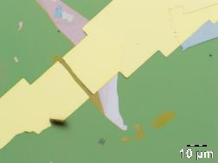
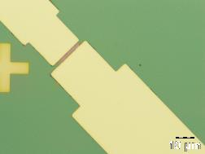
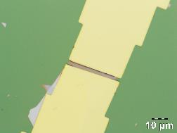
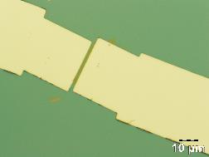
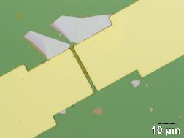
Sample 1
Device 1
Device 2
Device 3
Device 4
Device 3
Device 4
Device 1
Device 2
Device 5
Device 5

Slide 6
Sample1_device1
Device 1
ON/OFF = 0.22*10⁶
SS = 4.32 ± 0.16 V/dec
Vth = -8.75 ± 0.11 V
mu = 0.2156 ± 0.0013 cm²/(V*s)
trfSat and trfLin are fine, hysteresis is present, but small, however, the output curves show no field effect.

Slide 7
Sample1_device2
Device 2
ON/OFF = 0.04 * 10⁶
SS = 12.67 ± 0.08 V/dec
Vth = 6.87 ± 0.13 V
mu = 0.01684 ± 0.00010 cm²/(V*s)
At trfSat and trfLin a hysteresis is present, the output curves show no field effect.

Slide 8
Sample1_device3
Device 3
ON/OFF = 3.23*10⁶
SS = 2.71 ± 0.05 V/dec
Vth = -32.1 ± 0.7 V
mu = 0.0049±0.0002 cm²/(V*s)

Slide 9
Sample1_device4
Device 4
ON/OFF = 0.01*10⁶
SS = 8.70±0.12 V/dec
Vth = 4.6±0.3 V
mu = 0.01091±0.00002 cm²/(V*s)
At trfSat and trfLin a hysteresis is significant, however the output curves show good field effect.

Slide 10
Sample1_device5
Device 5
ON/OFF = -
SS = -
Vth = -
mu = -
No signal is observed, possibly, bad connection was present.

Slide 11
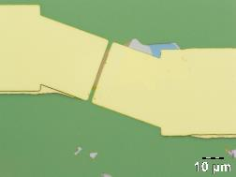
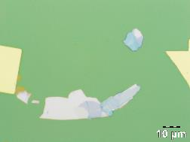
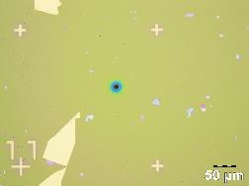
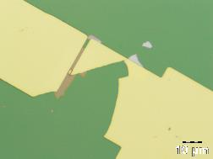
Sample 4
Device 1
Device 2
Device 4
Device 3
Device 2
Device 3
Device 4
Device 1

Slide 12
Sample4_device1
ON/OFF = 11.30*10⁶
SS = 2.85±0.04 V/dec
Vth = -43.0±0.6 V
mu = 0.478±0.012 cm²/(V*s)
trfSat is comparable to the one sent by Adrian, output curves show no field effect.

Slide 13
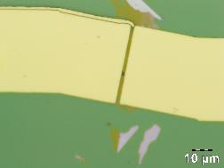
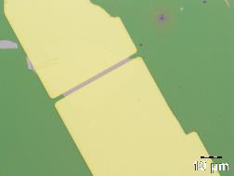
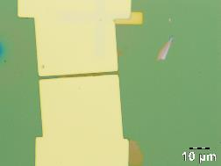
Sample 5
Device 1
Device 1
Device 2
Device 2
Device 4
Device 3
Device 4
Device 3

Slide 14
Sample5_device1
Device 1
ON/OFF = -
SS = -
Vth = -
mu = -
No signal is observed, probably, bad connection.

Slide 15
Sample5_device2
Device 2
ON/OFF = 0.04 *10⁶
SS = 5.085±0.26 V/dec
Vth = -4.62±0.08 V
mu = 0.01113±0.00006 cm²/(V*s)
At trfSat and trfLin significant hysteresis is observed, the output curves show no field effect.

Slide 16
Sample5_device3
Device 3
ON/OFF = -
SS = -
Vth = -
mu = -
No signal is observed (Idrain is almost zero), probably, bad connection.

Slide 17
Sample5_device4
Device 4
ON/OFF = -
SS = -
Vth = -
mu = -
No signal is observed.

Slide 18
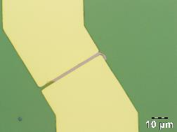
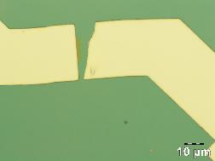
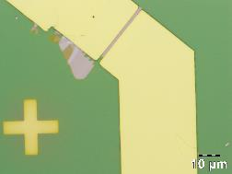
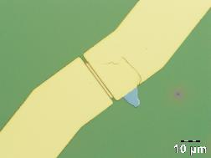
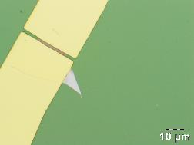
Sample 6
Device 1
Device 2
Device 3
Device 4
Device 3
Device 4
Device 2
Device 5
Device 5

Slide 19
Sample6_device1
Device 1
ON/OFF = 14.20*10⁶
SS = 4.98±00.10 V/dec
Vth = -15.61±0.07 V
mu = 0.96±0.007 cm²/(V*s)
trfSat and trfLin are fine, small hysteresis is present, the output curves show field effect at VGate below 30V.

Slide 20
Sample6_device3
Device 3
ON/OFF = -
SS = -
Vth = -
mu = -
No signal was observed, probably, bad connection.

Slide 21
Sample6_device5
Device 5
ON/OFF = 20.7*10⁶
SS = 4.66±0.10 V/dec
Vth = -6.30±0.10 V
mu = 0.2628±0.0014 cm²/(V*s)
At trfSat and trfLin hysteresis is present, output curves show good field effect.

Slide 22
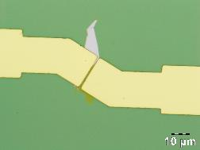
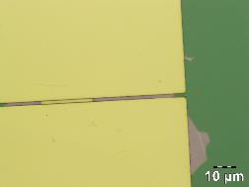
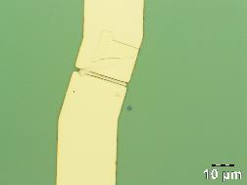
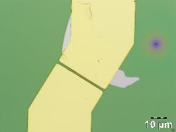
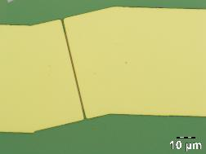
Sample 7
Device 1
Device 2
Device 3
Device 4
Device 4
Device 3
Device 1
Device 2
Device 5
Device 5

Slide 23
Sample7_device1
Device 1
ON/OFF = 3.18*10⁶
SS = 5.92±0.07 V/dec
Vth = -3.2±0.2 V
mu = 0.0483±0.0005 cm²/(V*s)
At trfSat and trfLin significant hysteresis is observed, the output curves show good field effect.

Slide 24
Sample7_device4
Device 4
ON/OFF = 0.00398*10⁶
SS = 6.5±0.3 V/dec
Vth = -9.23±0.08 V
mu = 0.00919±0.00004 cm²/(V*s)
At trfSat and trfLin significant hysteresis is observed, the output curves show absolutely no field effect.

Slide 25
Sample7_device5
Device 5
ON/OFF = -
SS = -
Vth = -
mu = -
No signal at trfSat is observed, at VGate=10V IDrain is about 10⁻¹⁰ A. The output curves show ohmic behaviour, which implies independence of the IDrain on VGate (ignorance of the gate from the active channel).

Slide 26
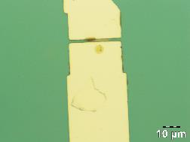
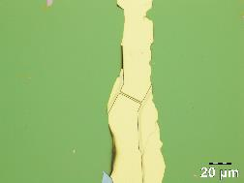
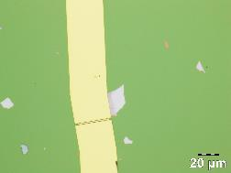
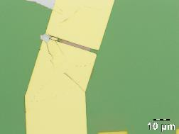
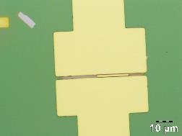
Sample 8
Device 1
Device 2
Device 3
Device 4
Device 5
Device 2
Device 4
Device 1
Device 5
Device 3
Device 6

Slide 27
Sample8_device1
Device 1
ON/OFF = 0.02*10⁶
SS = 9.57±0.12 V/dec
Vth = 10.76±0.16 V
mu = 0.2443±0.0016 cm²/(V*s)
At trfSat and trfLin hysteresis is observed, the output curves show good field effect.

Slide 28
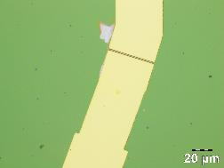
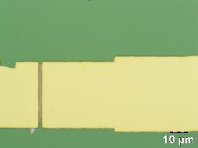
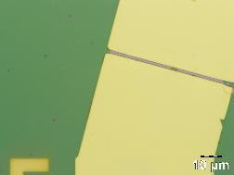
Sample 9
Device 1
Device 2
Device 3
Device 1
Device 3
Device 2

Slide 29
Sample9_device2
Device 2
ON/OFF = -
SS = -
Vth = -
mu = -
trfSat curve behaves well only below 0-10V (compliance?), trfLin performs well even with hysteresis, the output curves show good field effect. The measured properties are considered unreliable.

Slide 30
Sample9_device3
Device 3
ON/OFF = 0.82*10⁶
SS = 4.19±0.05 V/dec
Vth = -14.14±0.09 V
mu = 0.784±0.006 cm²/(V*s)
At trfSat and trfLin hysteresis is observed, the output curves show field effect at VGate <= 30V.

Slide 31
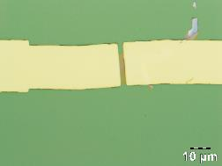
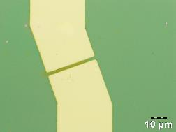
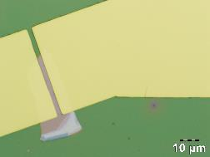
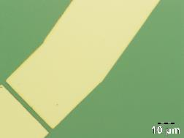
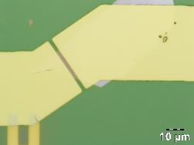
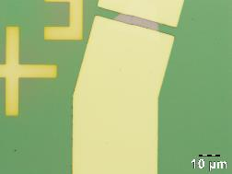
Sample 10
Device 1
Device 2
Device 3
Device 4
Device 2
Device 4
Device 6
Device 3
Device 5
Device 5
Device 6

Slide 32
Sample10_device1
Device 1
ON/OFF = -
SS = -
Vth = -
mu = -
trfSat is not finished because of constant interruption from the interlock, so I used the trfSat curve that got the longest measurement range. After that the connection between the sample and the tips was completely lost.

Slide 33
Sample10_device2
Device 2
ON/OFF = 0.50*10⁶
SS = 10.2±1.0 V/dec
Vth = 22.3±0.8 V
mu = 0.0197±0.0006 cm²/(V*s)
At trfSat and trfLin significant hysteresis is present, however, the output curves show good field effect.

Slide 34
Sample10_device3
Device 3
ON/OFF = 0.21*10⁶
SS = 2.54±0.05 V/dec
Vth = -28.37±0.08 V
mu = 0.713±0.004 cm²/(V*s)
trfSat and trfLin perform well with small hysteresis, the output curves show field effect at VGate below 30V.

Slide 35
Sample10_device5
Device 5
ON/OFF = -
SS = -
Vth = -
mu = -
No signal is observed, probably, bad connection.

Slide 36
Sample10_device6
Device 6
ON/OFF = 0.01*10⁶
SS = 8.50±0.17 V/dec
Vth = -45.0±0.4 V
mu = 0.329±0.005 cm²/(V*s)
trfSat and trfLin perform well with small hysteresis, the output curves show field effect only at VGate below -10V.

Slide 37
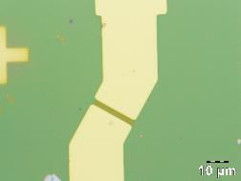
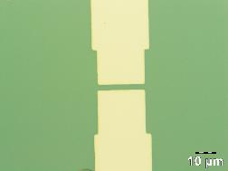
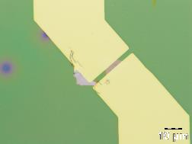
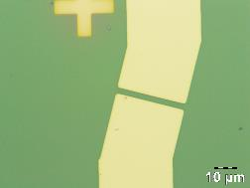
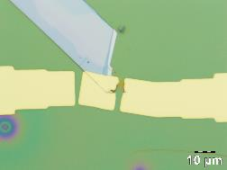
Sample 11
Device 1
Device 2
Device 1
Device 3
Device 4
Device 5
Device 3
Device 4
Device 5
Device 2

Slide 38
Sample11_device1
Device 1
ON/OFF = 0.000643*10⁶
SS = 13.9±0.10 V/dec
Vth = 20.2±0.7 V
mu = 0.0309±0.0008 cm²/(V*s)
trfSat and trfLin have significant hysteresis, however, the output curves show good field effect.

Slide 39
Sample11_device3
Device 3
ON/OFF = 6.44*10⁶
SS = 3.66±0.07 V/dec
Vth = -25.02±0.9 V
mu = 0.3481±0.0017 cm²/(V*s)
trfSat and trfLin perform well with small hysteresis, the output curves show field effect only at VGate below 30V.

Slide 40
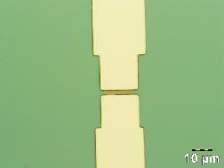
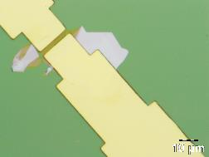
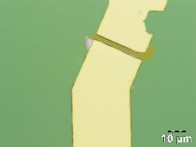
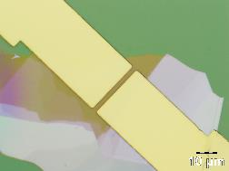
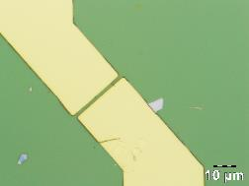
Sample 12
Device 1
Device 2
Device 3
Device 4
Device 1
Device 2
Device 5
Device 3
Device 5
Device 4

Slide 41
Sample12_device1
Device 1
ON/OFF = -
SS = -
Vth = -
mu = -
No signal is observed, probably, bad connection.

Slide 42
Sample12_device2
Device 2
ON/OFF = 0.07*10⁶
SS = 6.50±0.09 V/dec
Vth = 5.1±0.3 V
mu = 0.1231±0.0019 cm²/(V*s)
trfSat and trfLin have significant hysteresis, however, the output curves show good field effect.

Slide 43
Sample12_device3
Device 3
ON/OFF = 0.00326*10⁶
SS = 8.62±0.11 V/dec
Vth = -8.11±0.09 V
mu = 0.0677±0.0004 cm²/(V*s)
trfSat and trfLin have significant hysteresis, however, the output curves show absolutely no field effect.

Slide 44
Sample12_device4
Device 4
ON/OFF = 1.08*10⁶
SS = 6.411±0.004 V/dec
Vth = -10.20±0.10 V
mu = 0.0331±0.0003 cm²/(V*s)
trfSat and trfLin have medium hysteresis, the output curves show field effect only at VGate below 10V.

Slide 45
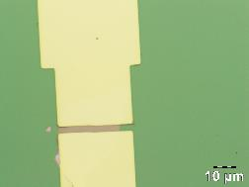
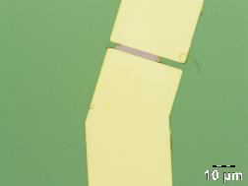
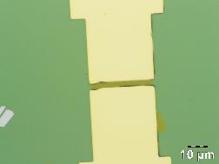
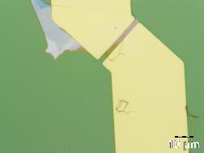
Sample 14
Device 1
Device 2
Device 2
Device 1
Device 3
Device 3
Device 4
Device 4

Slide 46
Sample14_device1
Device 1
ON/OFF = 9.18*10⁶
SS = 4.18±0.11 V/dec
Vth = -10.31±0.10 V
mu = 0.353±0.003 cm²/(V*s)
trfSat and trfLin perform well even with hysteresis, the output curves show field effect at VGate below 30V.

Slide 47
Sample14_device2
Device 2
ON/OFF = 15.80*10⁶
SS = 2.83±0.03 V/dec
Vth = -42.1±0.5 V
mu = 0.288±0.006 cm²/(V*s)
trfSat and trfLin perform well, however, the output curves are completely linear.

Slide 48
Sample14_device3
Device 3
ON/OFF = 12.10*10⁶
SS = 3.58±0.03 V/dec
Vth = -13.22±0.05 V
mu = 0.1267±0.0003 cm²/(V*s)
trfSat and trfLin have siginificant hysteresis, the output curves show field effect only at VGate below 10V.

Slide 49
Sample14_device4
Device 4
ON/OFF = 15.70*10⁶
SS = 2.67±0.03 V/dec
Vth = -55.3±0.7 V
mu = 0.274±0.007 cm²/(V*s)
trfSat and trfLin perfrom well, howeverm the output curves show absolutely no field effect.

Slide 50

Comparison with the data from literature:
Ji Heon Kim, Tae Ho Kim, Hyunjea Lee, Young Ran Park, Woong Choi, Cheol Jin Lee; Thickness-dependent electron mobility of single and few-layer MoS₂ thin-film transistors. AIP Advances 1 June 2016; 6 (6): 065106. https://doi.org/10.1063/1.4953809
Bottom gate, Top contact
SiO2 dielectric
Au electrodes
For 1L TFT:
Channel width W ∝ 10 um
Channel length L ∝ 5 um
Main parameters for 1L TFT:
ON/OFF ∝ 10⁷
mu ∝ 10 cm²/(V*s)
SS ∝ 60mV/decade
Deposition method – mechanical exfoliation
Schematic cross-section of a MoS₂ thin-film transistor fabricated in this study.
(b) Optical micrograph of a representative MoS₂ transistor.

Slide 51
Comparison with the data from literature:
2) Single-layer MoS2 Phototransistors, Yin, Zongyou & Li, Hai & Li, (Colin) Hong & Jiang, Lin & Shi, Yumeng & Sun, Yinghui & Lu, Gang & Zhang, Qing & Chen, Xiaodong & Zhang, Hua, https://doi.org/10.1021/nn2024557
Deposition method – mechanical exfoliation
MoS2 layer
Ti/Au electrodes
MoS2 layer:
Channel length L = 2.1 um
Channel width W = 2.6 um
Channel thickness th = 0.8 nm
SiO2 (300 nm)
Si (bottom gate)
Main parameters:
mu = 0.11 cm²/(V*s)
ON/OFF ∝ 10³

Slide 52

Comparison with the data from literature:
3) Radisavljevic, B., Radenovic, A., Brivio, J. et al. Single-layer MoS₂ transistors. Nature Nanotech 6, 147–150 (2011). https://doi.org/10.1038/nnano.2010.279
Deposition method – mechanical exfoliation
MoS2 layer:
Channel width W = 4 um
Channel length L = 1.5 um
Channel thickness th = 0.65 nm
Channel-Back gate capacitance per unit area: Ci = 1.3*10⁻⁴ F/m²
Main parameters:
mu (for back gate) ∝ 217 cm²/(V*s)
The result is not truly concrete, since in the same paragraph
they mention the mobility of 0.1-10 cm²/(V*s).

